Slide 1
CONDENSERS

Slide 2
NEED OF A CONDENSER
A condenser where the exhaust steam from the turbine is condensed operates at a pressure lower than atmosphere.
There are two objects of using a condenser in a steam plant:
1. To reduce the turbine exhaust pressure so as to increase the specific output of the turbine (Fig. 8.1).
If the circulating cooling water temperature in a condenser is low enough (say 30 °C), it creates a low back pressure (vacuum) for the turbine.
This pressure is equal to the saturation pressure corresponding to the condensing steam temperature (say 0.074 bar at 40 °C, Fig. 8.1), which, in turn, is a function of the cooling water temperature.
It is known that the enthalpy drop or turbine work per unit pressure drop is much greater at the low pressure end than at the high pressure end of a turbine.

Slide 3
A condenser by lowering the back pressure, say, from 1.013 to 0.074 bar, thus increases the plant efficiency and reduces the steam flow for a given output.
The lower the pressure, the greater the output and efficiency.
Hence, it is important to use the lowest possible cooling water temperature.
This restricts the temperature rise of cooling water in the condenser tubes to 5–8 °C so that the tube outer surface temperature remains low and consequently, the condensing steam temperature is low and vacuum is high.
2. To recover high quality feedwater in the form of condensate and feed it back to the steam generator without any further treatment.
As a result, only the makeup water to replenish the water losses in the cyclic plant needs be treated.

Slide 4
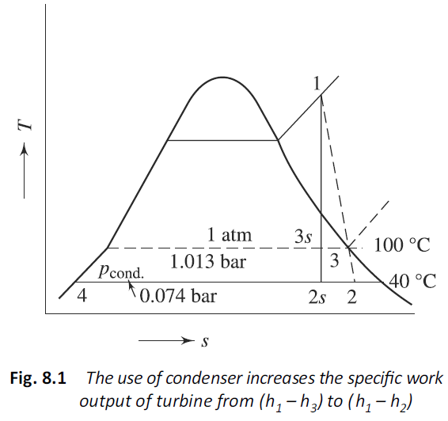

Slide 5
Types
There are two broad classes of condensers:
(a) Direct contact type condensers, where the condensate and cooling water directly mix and come out as a single stream.
(b) Surface condensers, which are shell-and-tube heat exchangers where the two fluids do not come in direct contact and the heat released by the condensation of steam is transferred through the walls of the tubes into the cooling water continuously circulating inside them.

Slide 6
DIRECT-CONTACT CONDENSERS
These can be of three types:
Spray condenser
(b) Barometric condenser
(c) Jet condenser
SPRAY CONDENSER
In a spray condenser, the cooling water is sprayed into the steam.
Steam by mixing directly with cold water gets condensed.
The exhaust steam from the turbine at state 2 mixes with cooling water at state 5 to produce saturated water at state 3, which is pumped to state 4 (Fig. 8.2).

Slide 7
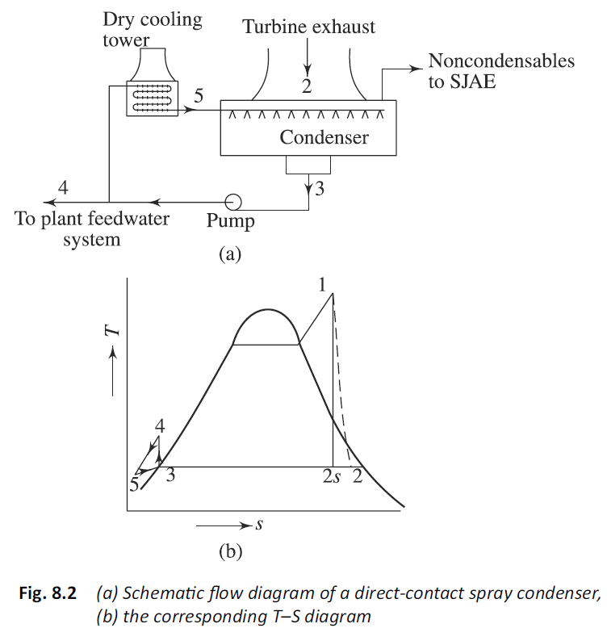

Slide 8
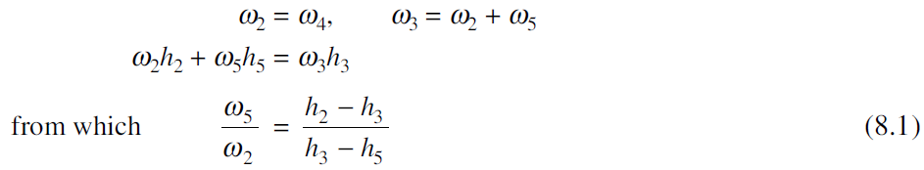
Part of the condensate (w4), equal to the turbine exhaust flow (w2) is sent back to the plant as feed water.
The remainder is cooled in a dry cooling tower to state 5, and is then sprayed on to the turbine exhaust.
Since the cooling water mixes with the steam and part of the condensate is used as feed water, the water must be of high purity.
For the spray condenser (Fig. 8.2), a mass balance and an energy balance give the following equations
Since h2 – h3 is much greater than h3 – h5, the circulating water flow (w5) is much larger than the steam flow (w2).

Slide 9
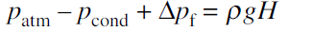
BAROMETRIC CONDENSERS
In a barometric condenser (Fig. 8.3a), the cooling water is made to fall in a series of baffles to expose large surface area for the steam fed from below to come in direct contact.
The steam condenses and the mixture falls in a tail pipe to the hot well below.
By virtue of its static head, the tail pipe compresses the mixture to atmospheric pressure.
Thus,

Slide 10
where ρ = density of mixture, H = height of tail pipe, and Δpf is the pressure drop due to friction.
For low values of Δpf, H is around 9.5 m.
Higher is the value of H, higher is the friction.
Friction is lowered by increasing the tail pipe diameter, which results in a tall and heavy system.
JET CONDENSER
In the jet condenser (Fig. 8.3b), the height of the tail pipe is reduced by replacing it with a diffuser.
The diffuser helps raising the pressure in a short distance than a tail pipe.

Slide 11
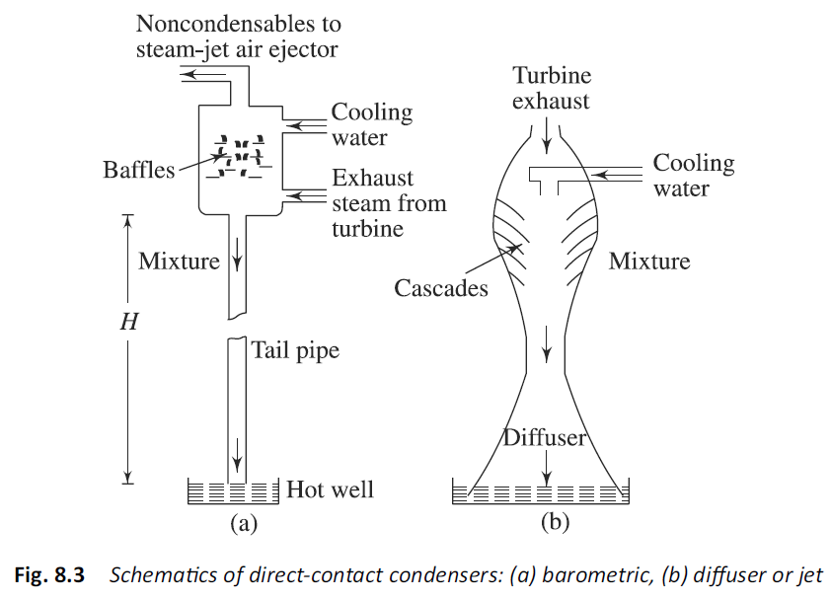
In spray-type condensers, the non-condensable gases are usually removed with a steam jet air ejector (SJAE), as discussed later.

Slide 12
SURFACE CONDENSERS
Surface condensers are mostly used in power plants.
They are essentially shell-andtube heat exchangers.
For the convenience of cleaning and maintenance, cooling water flows through the tubes and steam condenses outside the tubes.
Figure 8.4 shows a surface condenser with two passes on the water side.
It consists of a steel shell with water boxes on each side.
The right water box is divided to allow for two water passes.

Slide 13
At each end there are tube sheets into which the water tubes are rolled.
This prevents leakage of circulating water into the steam.
An expansion joint allows for the different rates of expansion between the tubes and shell.
There are vertical plates at intermediate points between the two tube sheets to provide support to the long tubes and to prevent tube vibration.
The hot well acts as a reservoir of the condensate with a capacity equal to the total condensate fl ow for a certain period of time, say 5 min.

Slide 14
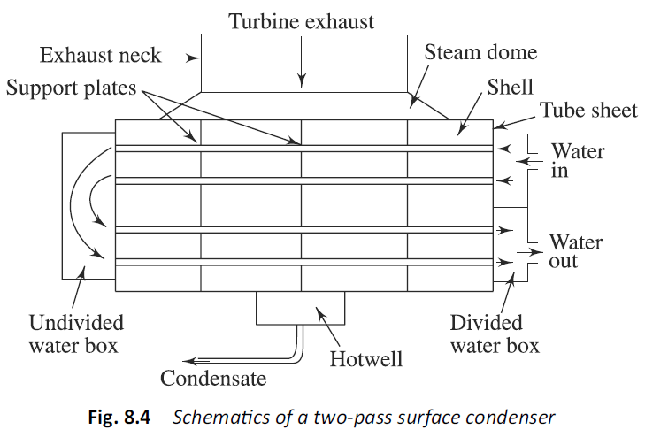

Slide 15
In a single pass condenser (Fig. 8.5), cooling water flows through the tubes
once, from one end to the other.
Compared to a two-pass condenser, a single-pass condenser with the same number and size of the tubes and with the same water velocity requires twice as much water flow but results in half the water temperature rise and therefore, lower condenser pressure.
Thus, a single-pass condenser is good for overall plant efficiency and reduces thermal pollution, but requires more than twice the water flow and hence, four times the pumping power.

Slide 16
Apart from the division required to allow for a number of water passes, the water boxes are often further divided.
For example, in a single-pass condenser, both the inlet and outlet water boxes are divided by a partition.
This permits to take off half the condensing surface out of service for cleaning while water flows through the other half to keep the unit running at half load (Fig. 8.5a).

Slide 17
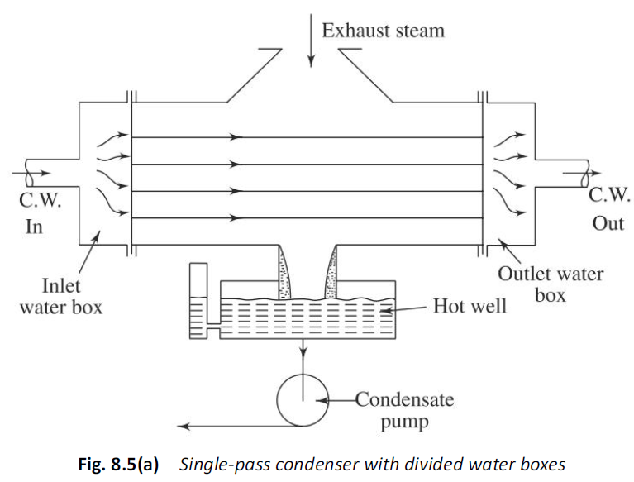

Slide 18
The tube arrangement in the condenser shell controls its effectiveness.
Older designs tended to crowd a maximum number of tubes inside the shell to make available as much surface area as possible.
Modern designs have steam lanes between tube banks to get maximum steam flow with least pressure drop and uniform distribution of steam in the shell.
Tube lengths of 9–15 m are now quite common.
Such long tubes result in a large rise in temperature of cooling water and the condensing ability decreases at the exit ends of the tubes.
Thus, the tubes are closer at the cold end than at the hot end.
To minimise the unequal distribution of steam flow from the turbine exhaust duct to condenser tubes, a well-tapered steam dome is added above the tube bundles.
An expansion joint provided between the turbine exhaust and the condenser inlet permits the condenser to be rigidly mounted on the fl oor (Fig. 8.5b).

Slide 19
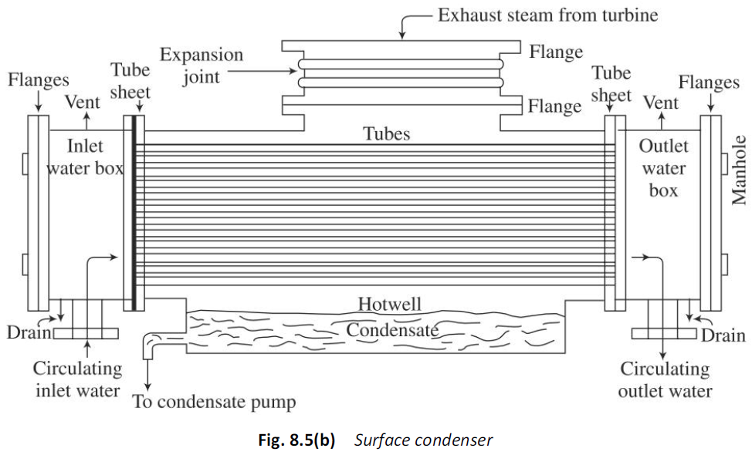

Slide 20
Figure 8.6 shows a typical modern two-pass surface condenser for a large steam power plant.
Steam enters the tube bundles in two separate sections from the top, sides and bottom, and flows toward the centre point most of steam has condensed leaving only air and other non-condensable gases which are cooled and removed by SJAE, as explained later.
The tube material can be
(a) cupronickel (70% copper, 30% nickel),
(b) aluminium brass (76% copper, 22% zinc and 2% aluminium),
(c) aluminium bronze (95% copper and 5% aluminium),
(d) muntz metal (60% copper, 40% zinc),
(e) admiralty alloy (71% copper, 28% zinc and 1% tin), or
(f) stainless steel.
The outside diameter of tubes is either 22 mm, 23 mm or 25.4 mm.
The length varies from 9 to 15 m. of the tube nest in each section. At that

Slide 21
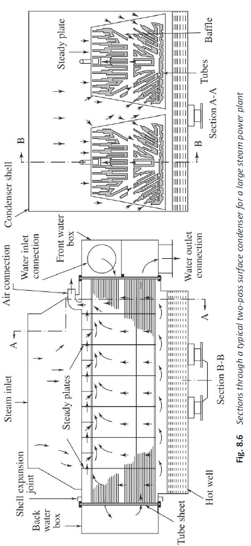

Slide 22
COOLING TOWERS
Cooling towers cool the warm water discharged from the condenser and feed the cooled water back to the condenser.
They, thus, reduce the cooling water demand in the power plant.
They can be either wet type or dry type.
WET COOLING TOWERS
Wet cooling towers have a hot water distribution system that showers or sprays water evenly over a lattice of horizontal slats or bars called fill or packing (Fig. 8.18).
The fill thoroughly mixes the falling water with air moving through the fill as the water splashes down from one fill level to another by gravity.
Outside air enters the tower through louvres on the side of the tower.
Intimate mixing of water and air enhances heat and mass transfer (evaporation), which cools the water.

Slide 24
More the water evaporates, more will be the cooling since the latent heat of evaporation is taken from water itself (evaporative cooling).
Cold water is collected in a concrete basin at the bottom of the tower, from where it is pumped back to the condenser.
Hot and moist air leaves the tower from the top.
Air entering the tower is unsaturated and as it comes in contact with the water spray, water continues to evaporate till the air becomes saturated.
So, the minimum temperature to which water can be cooled is the adiabatic saturation or wet bulb temperature of the ambient air.
At this temperature (WBT), air is 100% saturated and cannot absorb any more water vapour. Hence, there will be no further evaporation and cooling.
The humid air while moving up comes in contact with warm water spray and so the air temperature rises.

Slide 25
A cooling tower is specified by (a) approach, (b) range, and (c) cooling efficiency.
The approach (A) is defined as the difference between the exit temperature of cooling water and the wet bulb temperature of the ambient air, or
Warm water from the condenser enters the cooling tower at temperature tC1 and is cooled to temperature tC2 , higher than the minimum value, the wet bulb temperature, twb, and this unattainable temperature difference is the approach.
The approach varies from 6 °C to 8 °C.

Slide 26
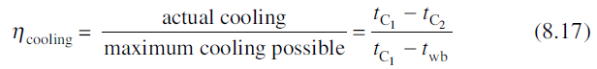
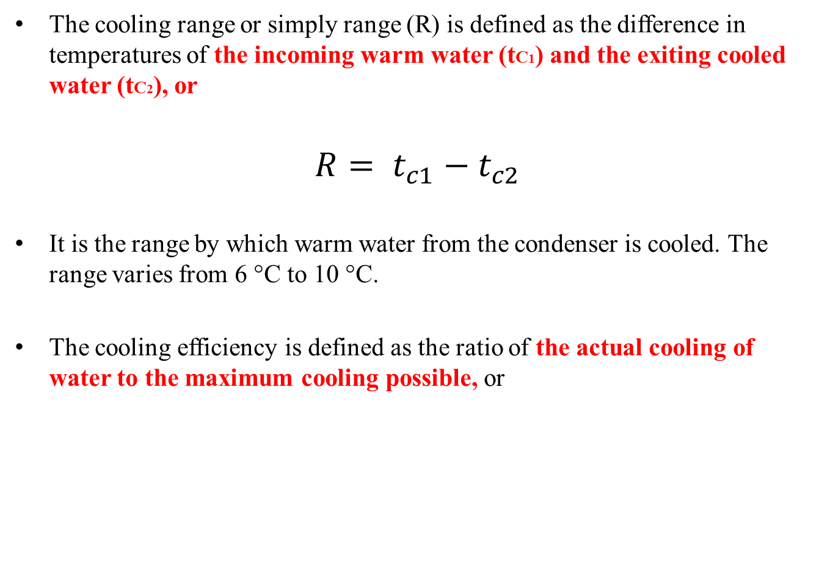
The cooling range or simply range (R) is defined as the difference in temperatures of the incoming warm water (tC1) and the exiting cooled water (tC2), or
$$R= t_{c1}−t_{c2}$$
It is the range by which warm water from the condenser is cooled. The range varies from 6 °C to 10 °C.
The cooling efficiency is defined as the ratio of the actual cooling of water to the maximum cooling possible, or

Slide 27
The approach, range and cooling efficiency are the performance parameters of cooling towers.
Wet cooling towers can be either mechanical draught or natural draught cooling towers.
MECHANICAL DRAUGHT
In mechanical draught cooling towers, air is moved through the fill by one or more fans driven by motors.
As in steam generators, the fans could be of the forced draught (FD) type or induced draught (ID) type.

Slide 28
FORCED DRAUGHT COOLING TOWERS.
The FD fan is mounted on the lower side of the tower (Fig. 8.19 b).
Since it operates on cooler air, it consumes less power.
However, it has the disadvantages of
(a) air distribution problems in the fill, often causing channeling of air flowing through paths of less flow resistance,
(b) leakage and
(c) recirculation of the hot and moist air back to the tower.

Slide 29
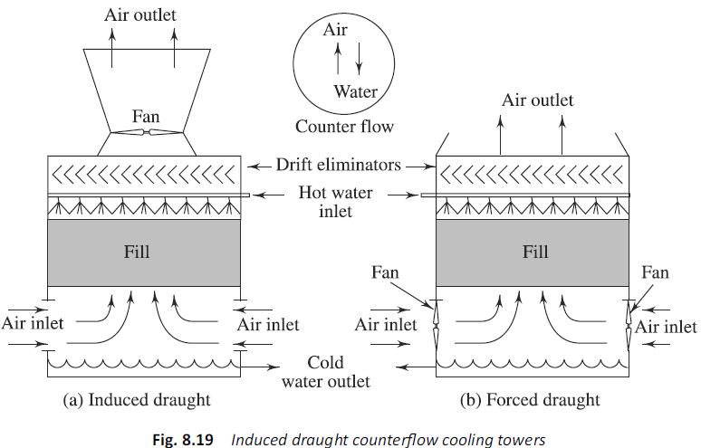

Slide 30
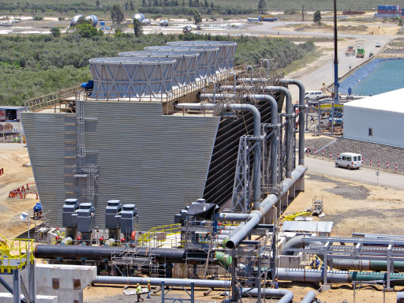

Slide 31
INDUCED DRAUGHT COOLING TOWERS.
Most of the mechanical draught cooling towers for utility applications are of the induced draught type.
The ID fan is located at the top of the tower Fig. 8.19(a).
Air enters the sides of the tower through large openings at low velocity and passes through the fill.
Hot humid air is exhausted by the fan at the top to the atmosphere.
It maintains the tower at a negative pressure thereby reducing leakage.
The ID fans are large, having 0.6 to 10 m in diameter.
They are driven by electric motors at low speeds through reduction gearing.
They are of the propeller type which deliver large volume flow of air at lower static pressures.
The blades are usually made of cast aluminium, stainless steel, or fibre glass so as to protect them from corrosion.

Slide 32
The air flow into the tower is more or less horizontal.
However, in the fill the flow can be horizontal or vertical, in which case it is either a cross-flow or a counter-flow cooling tower (Figs 8.20 and 8.21).
The main advantages of mechanical draught cooling towers are:
1. Low capital and construction costs,
2. Assured supply of the required quantity of air at all loads and climatic conditions,
3. Small physical structure.

Slide 33
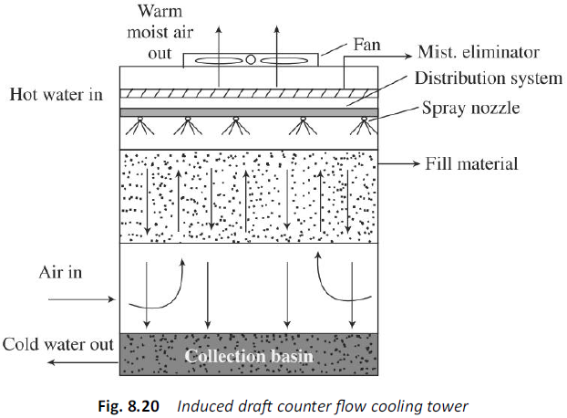

Slide 34
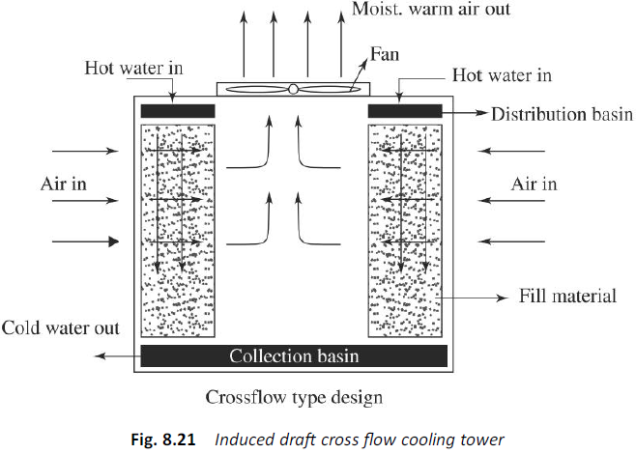

Slide 35
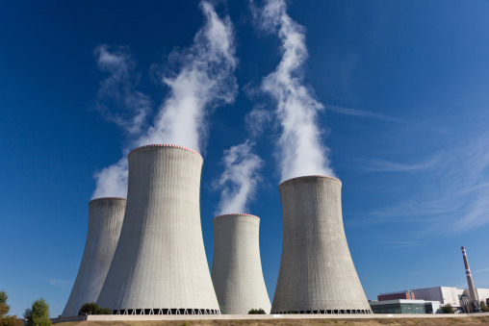
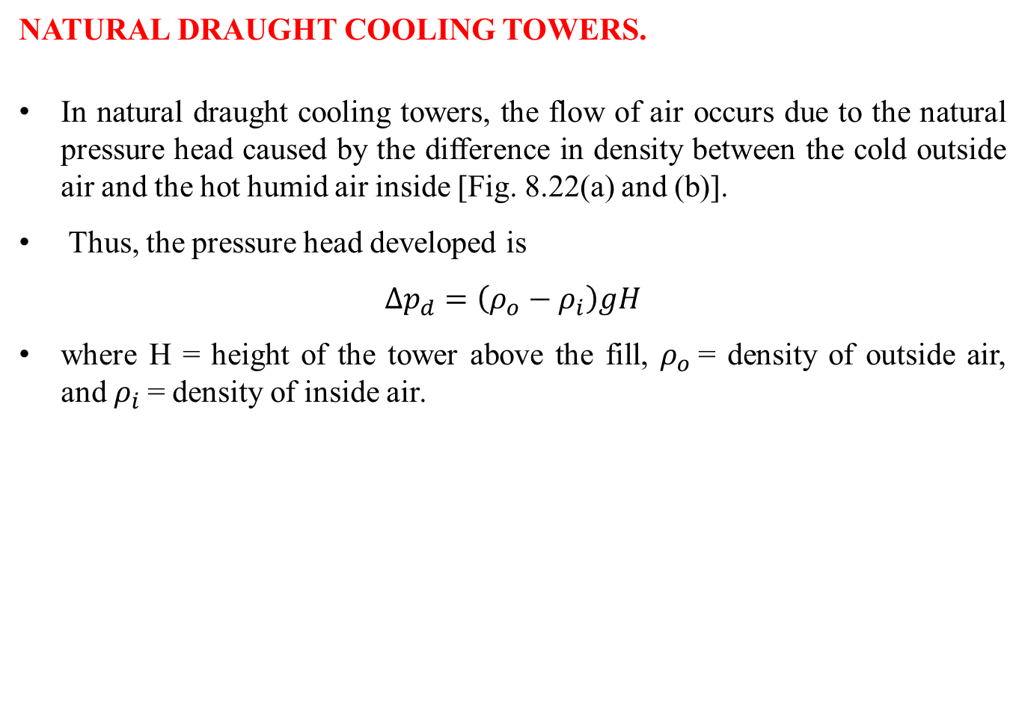
NATURAL DRAUGHT COOLING TOWERS.
In natural draught cooling towers, the flow of air occurs due to the natural pressure head caused by the difference in density between the cold outside air and the hot humid air inside [Fig. 8.22(a) and (b)].
Thus, the pressure head developed is
$${Δp}_{d}=\left(ρ_{o}−ρ_{i}\right)gH$$
where H = height of the tower above the fill, $ρ_{o}$= density of outside air, and $ρ_{i}$= density of inside air.

Slide 36
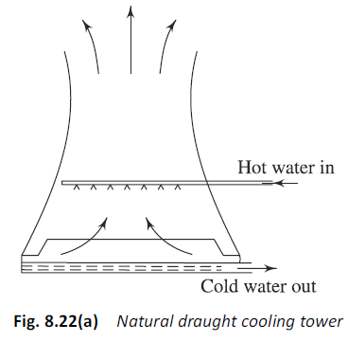

Slide 37
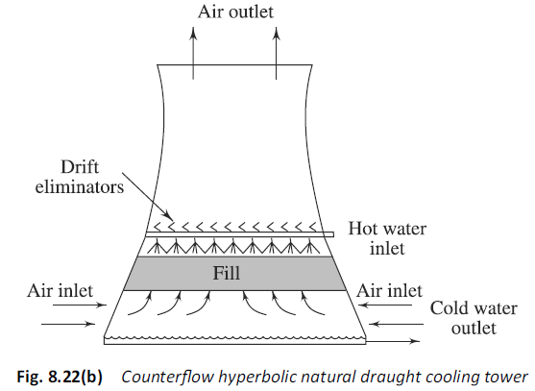

Slide 38
Because of relatively small density difference, ρo – ρi , H must be large so as to result in the desired ΔP_{d}, which must balance the air pressure losses in the tower.
Natural draught cooling towers are, therefore, very tall.
The tower body, above the water distribution system and the fill, is an empty shell of circular cross-section, but with a hyperbolic vertical profile.
The hyperbolic profile offers superior strength and the greatest resistance to outside wind loading compared to other forms.
Natural draught cooling towers are, therefore, often termed as hyperbolic towers.
Made of reinforced concrete, they are an imposing sight and are conspicuous from a distance.

Slide 39
Mechanical draught cooling towers are preferred when the approach is low and a broad range of water flow is expected.
The broad range is possible since they are made of multicell units with a variable air-flow fan.
These towers are, therefore, more versa tile and respond readily to changes in cooling parameters and demands.
Natural draught cooling towers are chosen
in cool, humid climates (low wet bulb temperature and high relative humidity),
when the wet bulb temperature is low and high condenser water inlet and outlet temperature, i.e. a broad range and a long approach, or
in heavy winter loads. However, their initial capital cost is high and occupy more space.
There is always some water loss in the cooling tower due to
(a) evaporation
(b) drift
(c) blow down

Slide 40
Water that evaporates leaves the tower along with air in the form of water vapour. The evaporation loss rate is 1–1.5 per cent of the total circulating water flow rate.
Drift is fine water drop lets entrained and carried by the air.
This water is thus lost to the circulating water system. Drift eliminators are provided at exit to minimise the drift loss (Fig. 8.23).
The baffles force the air to make a sudden change in direction. Heavier water particles separate out by gravity. Thus the drift loss is much less, about 0.03 per cent.
To maintain a certain solid concentration, blowdown is necessary from the cold water basin at the bottom of the tower. The blow down loss of water is also 1–1.5 per cent of the total water flow.
To replenish these losses, makeup water (2 – 2.2% of water flow) is added.

Slide 41
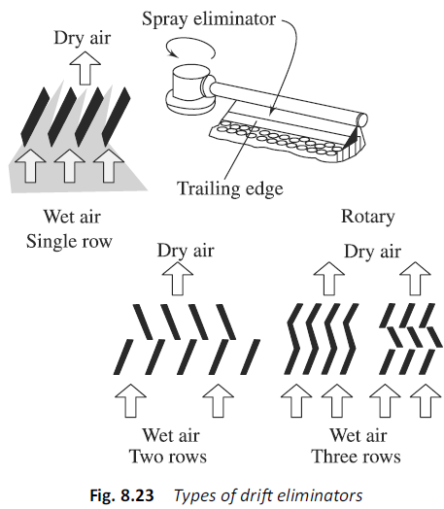

Slide 42
DRY COOLING TOWERS
Dry cooling towers are employed where cooling water is not avail able in plenty, even for the use of makeup.
In a dry tower, warm water from the condenser flows through finned tubes over which the cooling air is passed.
Heat is rejected to the air as water is cooled.
There are two basic types of dry cooling towers:
DIRECT AND INDIRECT.
In a direct dry cooling tower (Fig. 8.24), turbine exhaust steam flows into a large steam header and then to a large number of finned tubes which are cooled by atmospheric air blown over them by an FD fan.

Slide 43
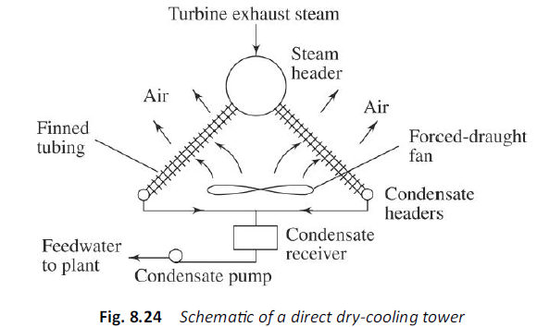

Slide 44
For an indirect dry cooling tower there are three designs.
The first uses a conventional surface condenser (Fig. 8.25). Warm water from the condenser flows through finned tubes and is cooled by atmospheric air blown over the tubes.
There are two heat exchangers in series, one between steam and water in the condenser and the other between water and air in the tower.

Slide 45
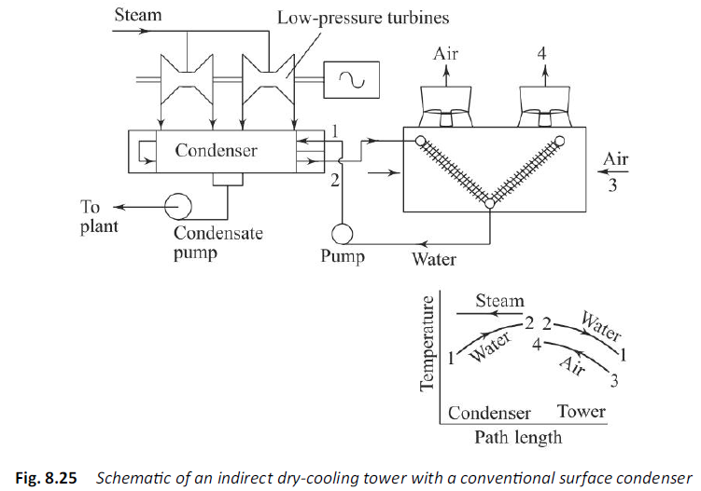

Slide 46
The second design uses a direct contact spray condenser (Fig. 8.26).
The turbine exhaust steam enters the open condenser and the cold circulating water is sprayed into the steam for intimate mixing.
The condensate falls into a bottom receiver from which a part is fed to the plant as feed water, and the remainder is pumped into finned tubes cooled by air flow to return to the condenser sprays.
Condensate polishers may be used to maintain the desired quality of feed water.

Slide 47
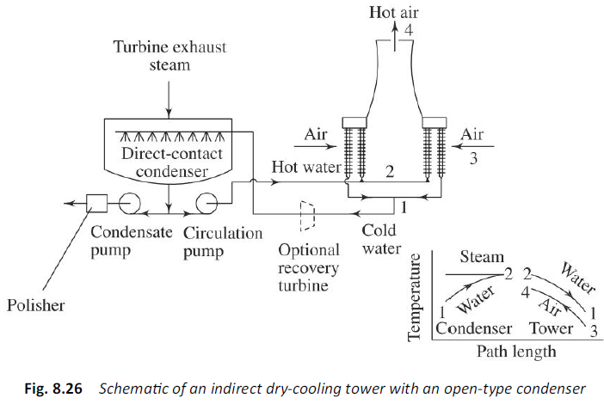

Slide 48
The third design of an indirect dry cooling tower employs ammonia as the coolant for the condenser (Fig. 8.27).
In the steam condenser ammonia evaporates.
In the dry tower ammonia condenses, rejecting the latent heat of condensation to the air which is heated.
Saturated liquid ammonia is then pumped back to the condenser.
Dry cooling towers have attracted much attention nowadays. Plants can be erected without regard for large supplies of cooling water.
Typical sites are near the sources of abundant fuel where there is no sufficient water.
Their disadvantages are that they are not so efficient as evaporative cooling, and that there is an increase in turbine exhaust pressure and a decrease in cycle efficiency.
However, as power plants grow bigger and water sources are dwindling, they are likely to receive greater attention in future.

Slide 49
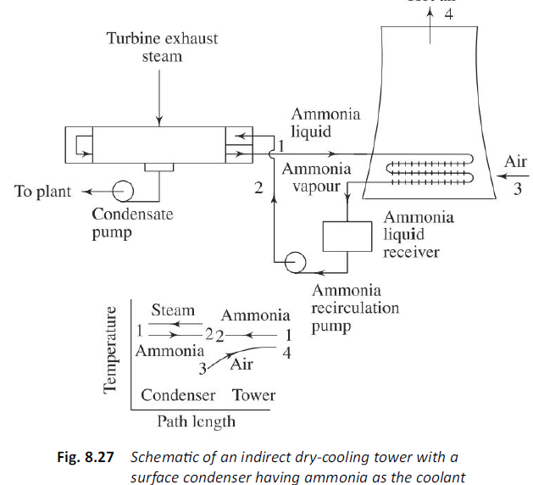

Slide 50
Introduction to Psychrometrics
Psychrometric
Branch of Engineering science which deals with the study of moisture air
Dry air
Atmospheric air consists of oxygen , nitrogen organ etc., is called dry air
Moisture air
Mixture of dry air and water vapor
Humidity
Fraction of water vapor present in the atmospheric air
Specific humidity
Mass of water vapor present in 1 kg of moisture air

Slide 51
Absolute humidity
Mass of water vapor present in 1m cube of moisture air
Relative humidity
Ratio of mass of water vapor present in 1 kg of moisture air to the mass of water vapor present in 1kg of saturated air
Saturated air
When the air got diffused maximum amount of water vapor into it at a given pressure & temperature
Dry bulb temperature
Temperature of air when measured with an ordinary thermometer
Wet bulb Temperature
Temperature of air when measured with a thermo meter with a wet cloth on the bulb.

Slide 52
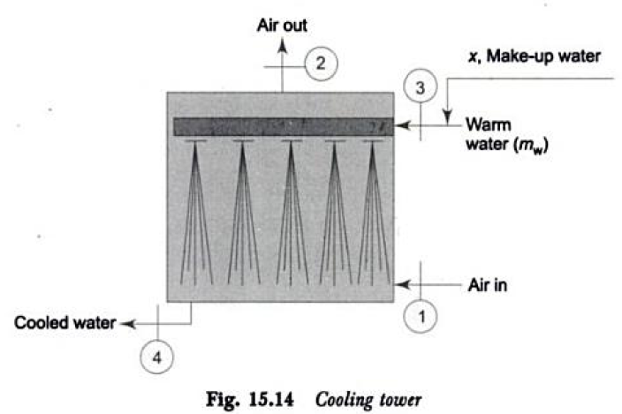
COOLING TOWER CALCULATIONS

Slide 53
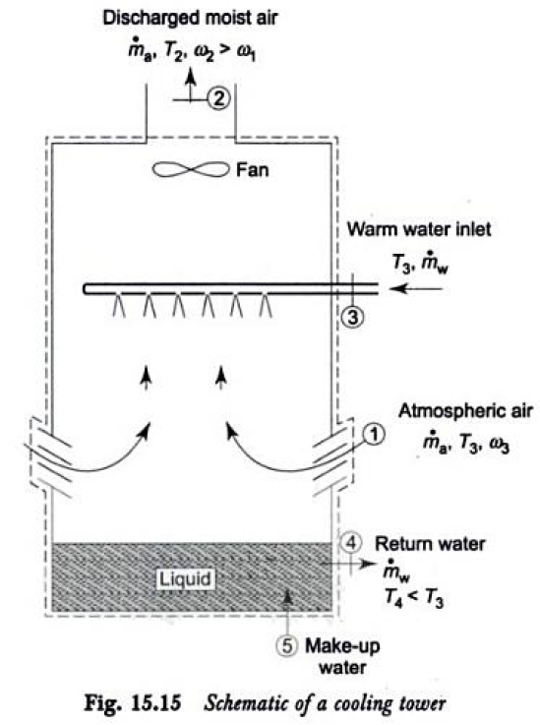

Slide 54
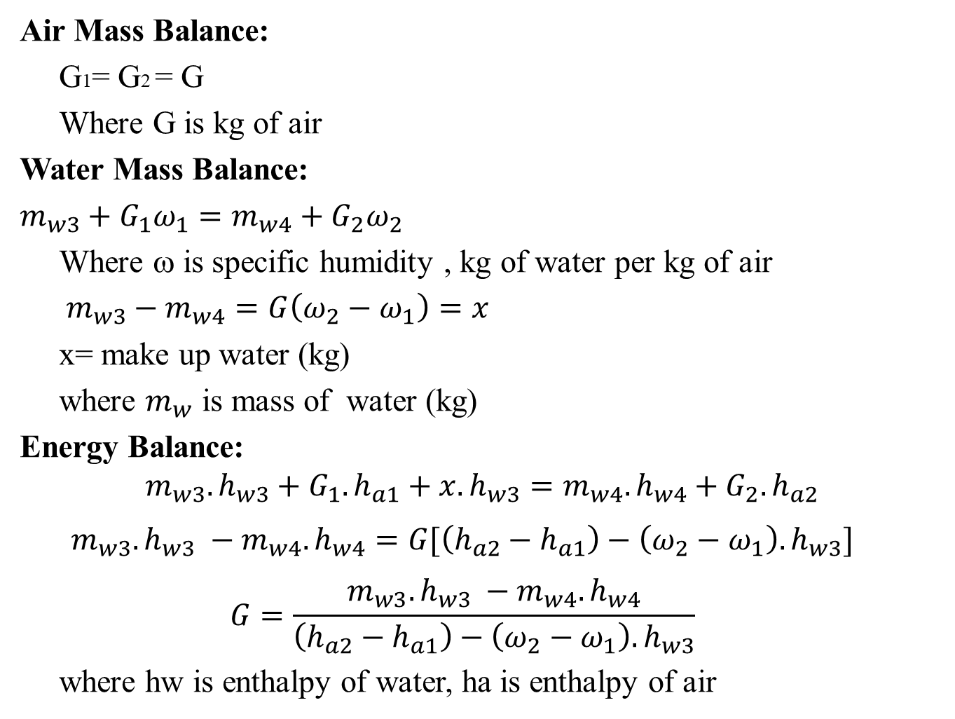
Air Mass Balance:
G1= G2 = G
Where G is kg of air
Water Mass Balance:
$m_{w3}+G_{1}ω_{1}=m_{w4}+G_{2}ω_{2}$
Where ω is specific humidity , kg of water per kg of air
$m_{w3}−m_{w4}=G\left(ω_{2}−ω_{1}\right)=x$
x= make up water (kg)
where $m_{w}$ is mass of water (kg)
Energy Balance:
$$m_{w3}.h_{w3}+G_{1}.h_{a1}+x.h_{w3}=m_{w4}.h_{w4}+G_{2}.h_{a2}$$
$$m_{w3}.h_{w3} −m_{w4}.h_{w4}=G[\left(h_{a2}−h_{a1}\right)−\left(ω_{2}−ω_{1}\right).h_{w3}]$$
$$G=\frac{m_{w3}.h_{w3} −m_{w4}.h_{w4}}{\left(h_{a2}−h_{a1}\right)−\left(ω_{2}−ω_{1}\right).h_{w3}}$$
where hw is enthalpy of water, ha is enthalpy of air

Slide 55
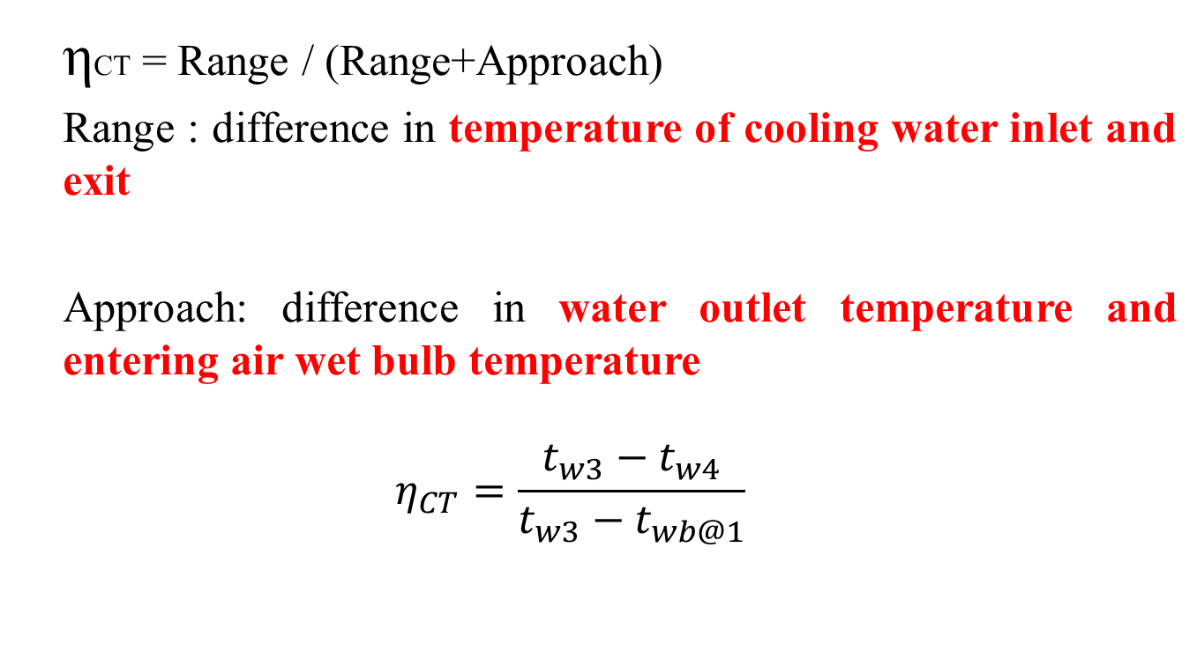
Efficiency of cooling tower
ηCT = Range / (Range+Approach)
Range : difference in temperature of cooling water inlet and exit
Approach: difference in water outlet temperature and entering air wet bulb temperature
$$η_{CT}=\frac{t_{w3}−t_{w4}}{t_{w3}−t_{wb@1}}$$

Slide 56
PCT1. Water at 30°C flows into a cooling tower at the rate of 1.15 kg per kg of air. Air enters the tower at a dbt of 20°C and a relative humidity of 60% and leaves it at a dbt of 28°C and 90% relative humidity. Make-up water is supplied at 20°C. Determine:
(i) the temperature of water leaving the tower,
(ii) the fraction of water evaporated, and
(iii) the approach and range of the cooling tower.

Slide 57
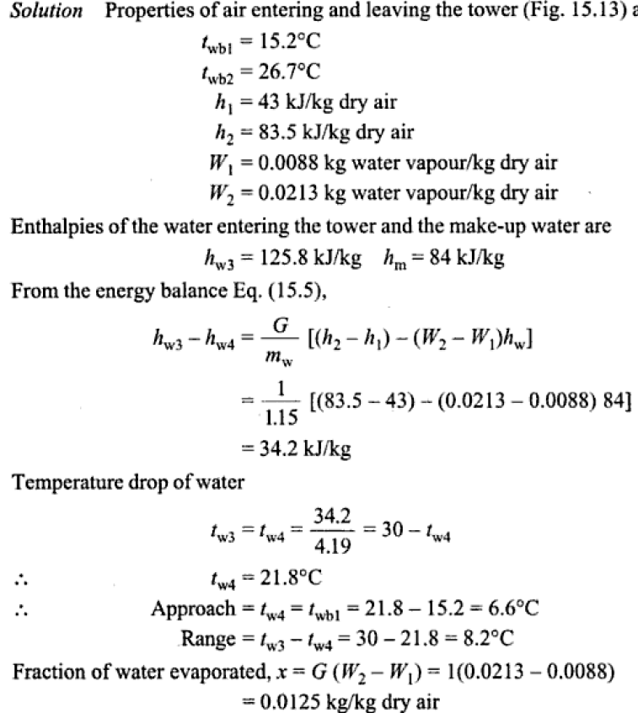

Slide 58
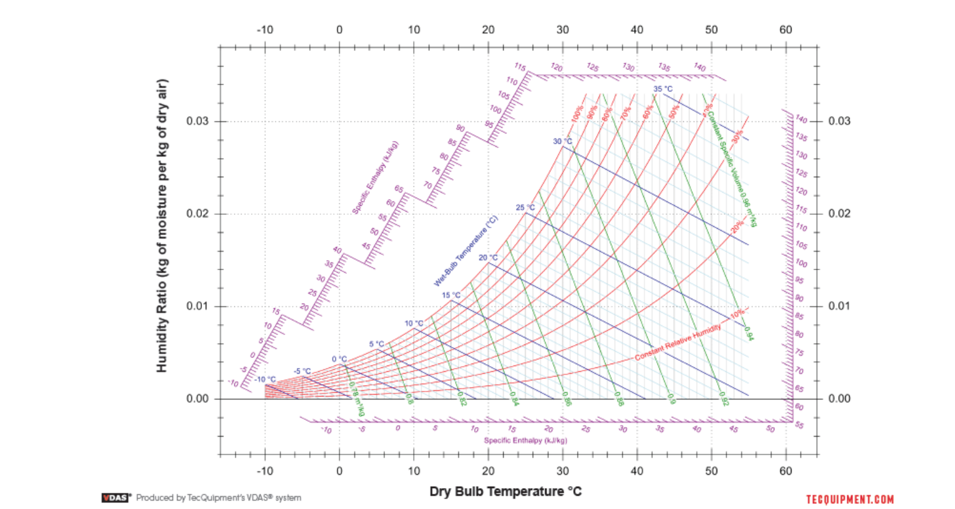

Slide 59
PCT2.Water from a cooling system is itself to be cooled in a cooling tower at a rate of 2.78 kg/s. The water enters the tower at 65°C and leaves a collecting tank at the base at 38°C. Air flows through the tower, entering the base at 15°C, 0.1 MPa, 55% RH, and leaving the top at 35°C, 0.1 MPa, saturated. Make-up water enters the collecting tank at 14°C. Determine the air flow rate into the tower in m3/s and the make-up water flow rate in kg/s.
[Ans. 3.438 m3/s, 0.129 kg/s]

Slide 60
Turbine Governing and Control
The function of a governor is to maintain the shaft speed constant as the load varies.
The simplest type of governor is the centrifugal fly ball type (Fig. 7.50).
The power available at the shaft is equal to 2πTN/60, where T is torque and N is the rpm.
As load (or torque) decreases, speed increases.
Consequently, with the increase of centrifugal force, the fly balls fly apart and raise the sleeve which, operating through a lever and a fulcrum, actuates the main valve to close and reduce the mass flow of steam admitted to the turbine.

Slide 61
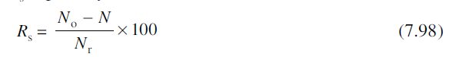
An oil-operated servo system in addition may be used to enhance the sensitivity of the governor (Fig. 7.51).
The governor force is amplified to move a light and almost frictionless pilot valve which controls the flow of high pressure oil to a piston.
The piston powered by the oil can thus operate the governor valve as desired.
The steady state speed regulation Rs is given by
where No = speed at no load,
N = speed at rated load, and
Nr = rated speed.

Slide 62
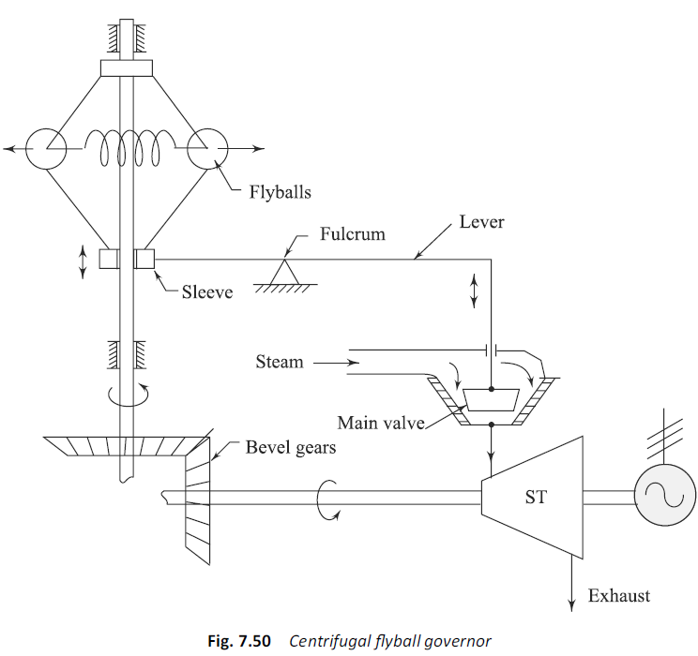

Slide 63
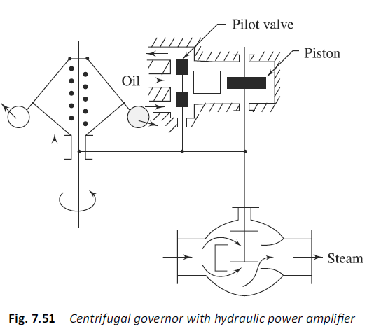

Slide 64
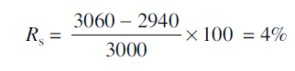
Usually, the speed change from full load to no load is limited to 3–4% of the speed at rated load.
If the rated speed is 3000 rpm, the speed at no load would be 3060 rpm and that at full load would be 2940 rpm.
Therefore, in this case

Slide 65
Throttle Governing
It was mentioned in the earlier section that as the load decreases and shaft speed increases, the stop valve is partially closed to admit less steam to the turbine and to produce less power according to the demand.
Due to restriction of passage in the valve, steam is throttled, say, from p0 to pthrottle (Fig. 7.52).
The specific ideal output of turbine thus reduces from (h1 – h2s) to (h3 – h4s).
With further closure of the valve, pthrottle will still be less to produce a still lower output.

Slide 66
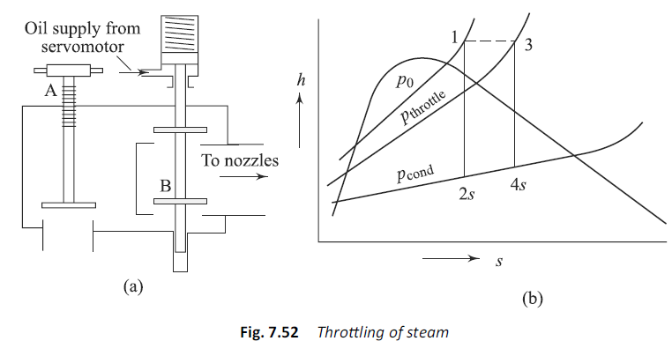

Slide 67
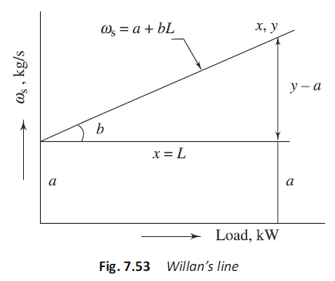
The steam consumption plotted against the turbine load shows a linear relationship, which is called the Willan’s line (Fig. 7.53), and given by

Slide 68
where a = no load steam consumption, kg/s;
b = steam rate (or specifi c steam consumption),kg/kWs; and L = load, kW.
The throttle and stop valves are located in the steam supply line to the turbine.
The stop valve is a hydraulically operated quick opening and shutting valve designed to be either fully open or shut.
For small turbines, the stop valve may be manually operated.
The throttle valve is used to regulate steam flow during starting or stopping.

Slide 69
Nozzle Governing
If throttle governing is done at low loads, the turbine efficiency is considerably reduced.
The nozzle control may then be a better method of governing.
The nozzles are made up in sets, each set being controlled by a separate valve (Fig. 7.54).
With the decrease of load, the required number of nozzles may be shut off.

Slide 70
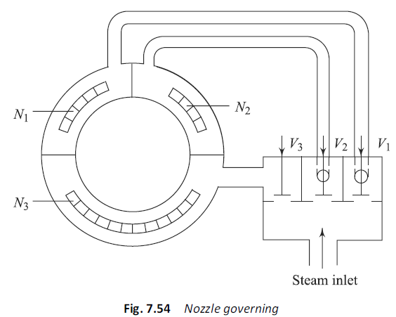

Slide 71
By-pass Governing
To produce more power (when on overload), additional steam may be admitted through a by-pass valve to the later stages of the turbine (Fig. 7.55).
By-pass regulation operates in a turbine which is throttle governed.

Slide 72
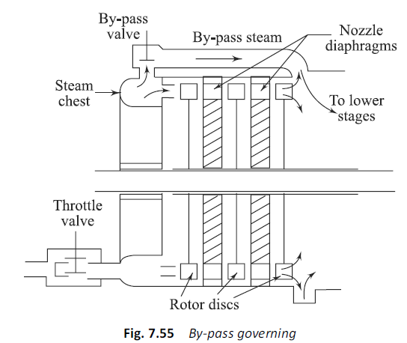

Slide 73
Emergency Governor
Every turbine is provided with some form of an emergency governor which trips the turbine (closes the stop valve and stops the steam supply) when
(a) shaft exceeds 110% of its rates value, i.e. 3300 rpm
(b) lubrication system fails
(c) balancing (static as well as dynamic) of turbine is not proper
(d) condenser becomes hot (due to inadequate cooling water circulation) or vacuum is less.

Slide 74
One common type of over speed trip employs a pin or weight on the turbine shaft.
Centrifugal force acting on the pin is opposed by a spring until about 10% over speed is reached, whereupon, the centrifugal force overcomes the spring force and the pin flies out and strikes a trigger which, in turn, releases a spring to close the stop valve immediately.

Slide 75
Power Plant Economics
Economics is branch of social science which deals with production, distribution and consumption of goods services and their management.
Power plant economics is defined as science which deals with production, distribution and consumption of the power.
Power Plant design must be based on most economical conditions but not on most efficient conditions.
Cost analysis of Power Plant gives different costs involved in a Power Plant design and setup.

Slide 76
Cost analysis of Power Plant
Cost of a Power Plant depends on
1.Whether an entire new system has to be setup
2. Whether modifications of the existing system
3. Extension of existing system

Slide 77
Types of Costs
CAPITAL COST/ FIXED COST
Initial cost
Interest
Depreciation
Taxes
Insurance
II. OPERATIONAL COST
Fuel cost
Operating labour cost
Maintenance cost
Supervising cost
Operating Taxes
Stores & Purchase

Slide 78
Factors influencing the Initial cost
Location of the plant
Time of construction
Size of units
No. of main generating units
Type of structure to be used

Slide 79
Initial cost includes
Land cost
Building cost
Equipment cost
Installation cost
Overhead charges

Slide 80
Interest
Interest is defined as Money returned – Money borrowed
Type of Interests:
Simple interst
Compound interst

Slide 81
Depreciation
It is defined as deterioration of equipment and decrease in its value due to corrosion, weathering , wear & tear with use.
Cause of depreciation:
Physical causes
Abnormal occurrences
Technological developments
Custom / usage

Slide 82
Methods of Calculation of depreciation fund
Straight line method
Percentage method
Sinking fund method
Sum of the years digits method
Unit method

Slide 83
Straight line method
Life of equipment is assesed
Salvage value is assesed at the end of life of equipment
Depreciation fund = (I – S) / n
Where I is initial cost
S is salvage value
n is life in years

Slide 84
Percentage method
Deterioration in value of equipment is taken into account and depreciation is calculated on actual residual value by a fixed percentage.
Thus DF reduces year by year

Slide 85
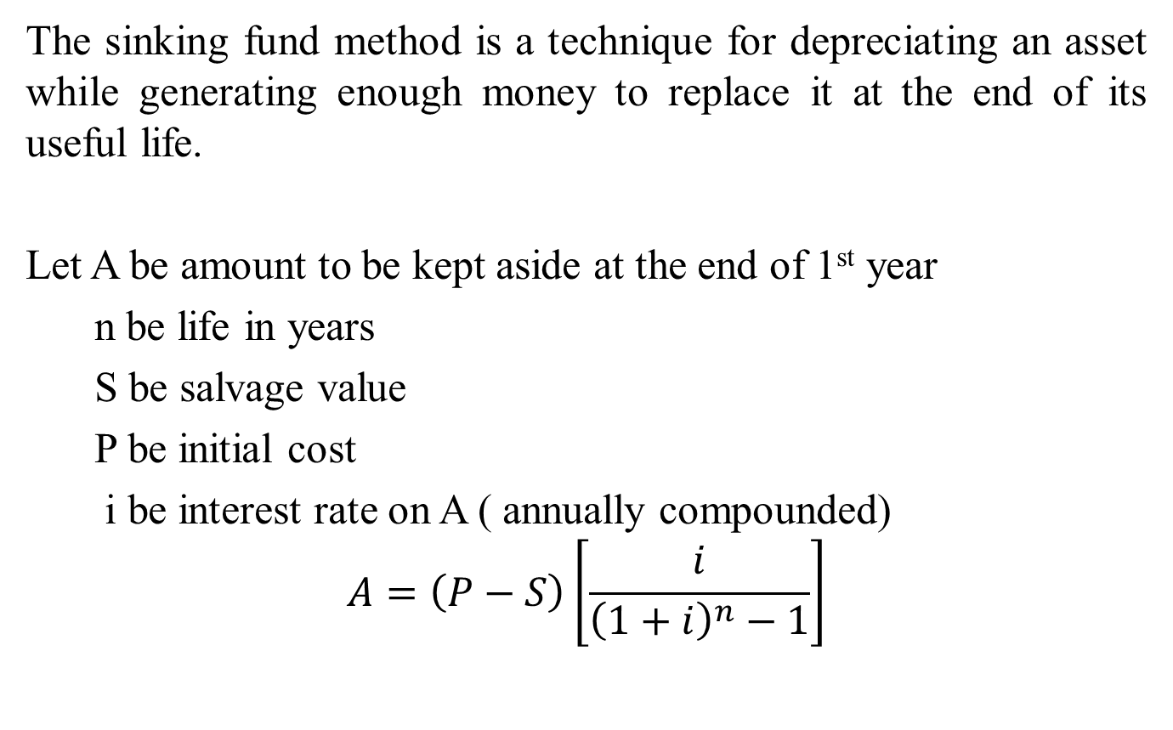
Sinking fund method
The sinking fund method is a technique for depreciating an asset while generating enough money to replace it at the end of its useful life.
Let A be amount to be kept aside at the end of 1st year
n be life in years
S be salvage value
P be initial cost
i be interest rate on A ( annually compounded)
$$A=\left(P−S\right)\left[\frac{i}{{\left(1+i\right)}^{n}−1}\right]$$

Slide 86
Sum of the years digits method
In this method takes the asset's expected life and adds together the digits for each year.
So if the asset was expected to last for five years, the sum of the years' digits would be obtained by adding: 5 + 4 + 3 + 2 + 1 to get a total of 15.
Each digit is then divided by this sum to determine the percentage by which the asset should be depreciated each year, starting with the highest number in year 1

Slide 87
Unit method
Depreciation Fund is calculated based on a standard unit may be by no. of hours of working per year or no. of units produced.
Thus DF at the end of each year is calculated for total life period say ‘n’ years, the amount obtained may be used for purchasing new equipment by adding it to salvage value.

Slide 88
LOAD–DURATION CURVES
The load required by a consumer does not remain constant with respect to time (hour, day, or month) and it fluctuates according to his requirement.
The voltage of electricity generated is raised by a step-up transformer, transmitted along high voltage lines to sub-stations, and reduced to low voltage by step-down transformer, before distributing to different consumers.
A curve showing the load demand variations of consumers with respect to time is known as load curve.
If the time is in hours the load curve is known as daily load curve (Figs 1.3).

Slide 89
If the time is in days, the load curve is known as monthly load curve and if the time is in months, the load curve is known as yearly or annual load curve.
This type of load curve is useful in predicting the annual requirements of energy and capacity of the power plant required.
When planning a power plant, the two basic parameters to be decided are:
1. Total power output to be installed (kWinst).
2. Size of the generating units.

Slide 90
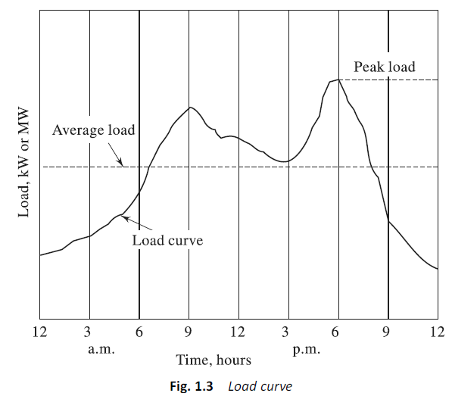

Slide 91
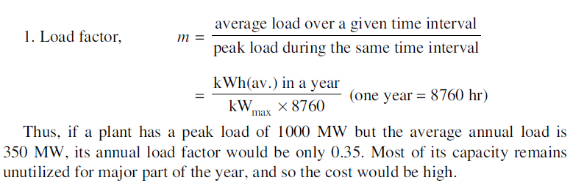
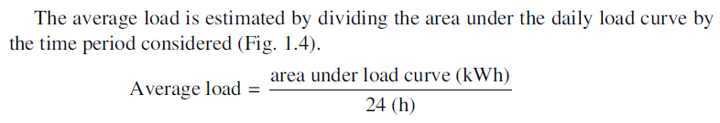

Slide 92
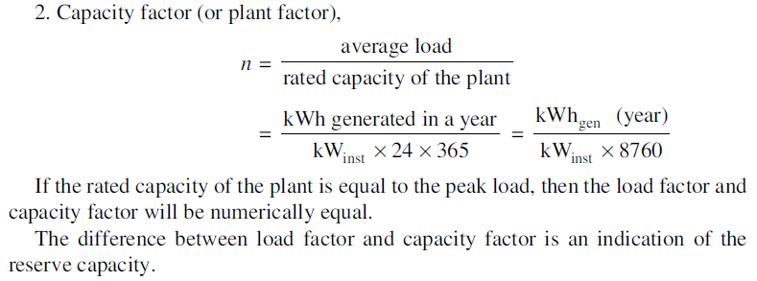

Slide 93
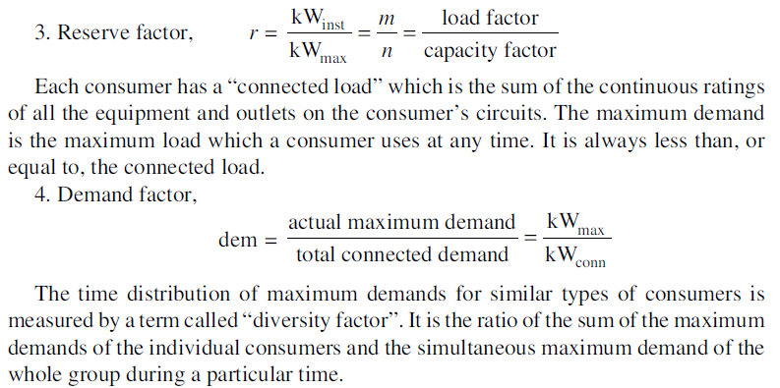
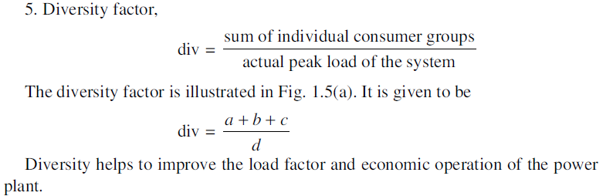

Slide 94
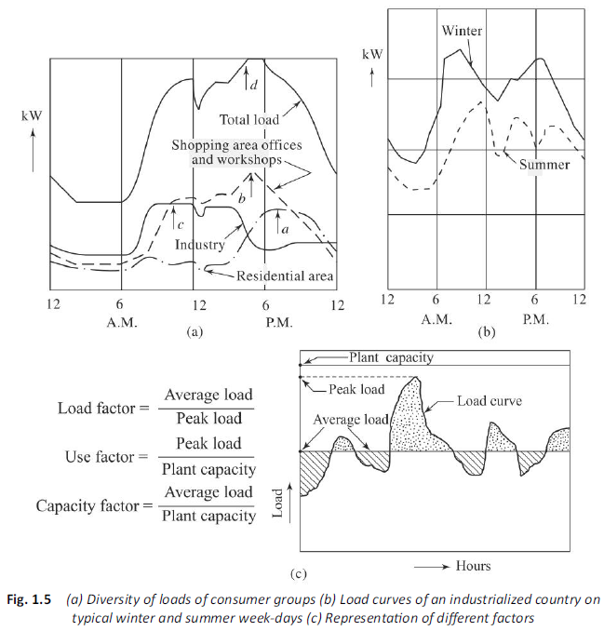

Slide 95
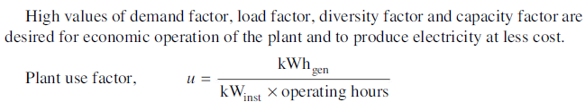
is the ratio of energy produced in a given time to the maximum possible energy that could have been produced during the same time of operation.
If the operating time is 1 year or 8760 hrs, the plant use factor is equal to the capacity factor (i.e., u = n)
As the plant-use factor approaches 1, it indicates the need for additional capacity of the plant.
The plant capacity is always designed to be greater than the peak load to take extra loads coming in future.

Slide 96
The high value of the plant use factor indicates that the plant is operating quite efficiently.
In some inter-connected systems, the plant use factor may exceed unity (e.g., 1.1 or 1.2) indicating that the loads carried are in excess of the rated capacity since an equipment is always de signed to take 10 to 20% more load than rated.
The different factors are indicated in Fig. 1.5(c).

Slide 97
Larger the unit size, less is the cost of electricity produced.
Therefore, larger units are more economical than smaller units as regards investment per kW and operating expenses per kWh.
Investigations should be made in each individual case, considering all operational, technical and economic factors involved, to determine the maximum unit size admissible.
A reserve factor of 1.2 to 1.25 is often found to be satisfactory.
The unit size must not exceed 20 to 25% of the total generating capacity of the plant.

Slide 98
In order to obtain a basis for economical operation of the various types of generating units normally connected to a grid and also for planning of tariffs, it is useful to construct load duration curves for typical days which indicate the power demands at different intervals of time.
There can be residential loads (domestic lights, heaters, refrigerator, TV, audio and video cassette recorders, etc.), commercial loads (shops, offices, advertisements, restaurants, etc.), industrial loads (various mills and factories), municipal loads (street lighting, power for water supply and drainage), irrigation loads and traction loads (railways, trams, trolleys, etc.).

Slide 99
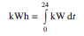
The construction of a load duration curve for one day from the chronological load curve of this day is illustrated in Fig. 1.6(b).
It rearranges the load elements of a chronological curve in the descending order of magnitude. The area under the curve is during the day.
The load duration curve indicates for how many hours a certain load has been required in the course of the day.
By compiling the load hours on various days, the load duration curves for one month (720 hours) or one year (8760 hours) can be obtained (Fig. 1.6).
Daily, monthly and yearly load duration curves aid better planning for economical utilization of the power plants, existing or planned.

Slide 100
Figure 1.7 shows the construction of a load-duration curve using the daily load curve.
The area under the annual load duration curve represents the total energy supplied by the utility’s generating system during the year.
It is usually divided into three parts:
1. Base load
2. Intermediate load
3. Peaking load
The base load is the load below which the demand never falls and is supplied 100% of the time.
The peaking load occurs for about 15% of the time.
The intermediate load represents the remaining load region.

Slide 101
Since peaking load plants are used only for a small fraction of time, the fuel cost is not of major importance.
Minimum capital cost should be the criterion.
The base load plants are plants which are loaded very heavily.
Operating costs of such plants are very important.
A high capital cost is permissible if low operating costs can be maintained (e.g. new, large coal and nuclear power stations).
Intermediate load plant can be somewhat smaller than older units. By judicious combination of all the tree types of generation—peak, intermediate and base—maximum economy can be achieved.

Slide 102
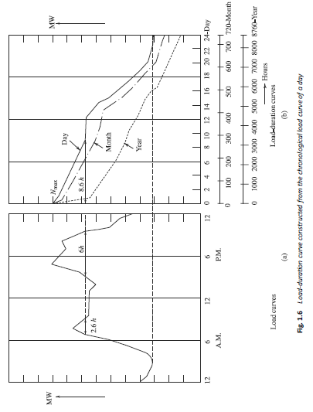

Slide 103
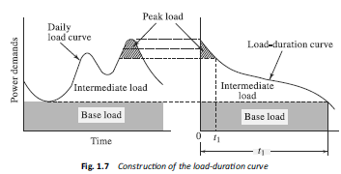

Slide 104
The variable load problem affects power plant design and operation as well as the cost of generation.
A careful study of the load duration curve helps to decide the capacity of the base load plant and also of the peak load plant.
The base load plant should be run at high load factor.
The peak load plant should be of smaller capacity to reduce the cost of generation.
It could be a gas turbine unit, pumped hydro-system, compressed air energy storage system or a diesel engine depending on the size and scope of availability.

Slide 105
If the whole of load is to be supplied by the same power plant then the prime movers and generators should act fairly quickly and take up or shed load without variation of the voltage or frequency of the system.
It is the function of the governor to control the supply of fuel to the prime mover according to load.
The capacity of the generators should be so chosen as to suit and fit into the portions of the predicted load curve.
If the load conditions differ too much from this capacity, the cost of energy increases.

Slide 106
Problems on load curves

Slide 107

P1. A power station supplies the following loads to the consumers:
(a) Draw the load curve and estimate the load factor of the plant.
(b) What is the load factor of a standby equipment of 30 MW capacity if it takes up all loads above 70 MW? What is its use factor?

Slide 108

SOL. (a) The load curve is drawn in Fig. E1.1.

Slide 109



Slide 110


Slide 111
P2.The peak load on a power plant is 60 MW. The loads having maximum demands of 30 MW, 20 MW, 10 MW and 14 MW are connected to the power plant. The capacity of the power plant is 80 MW and the annual load factor is 0.50. Estimate
(a) the aver age load on the power plant,
(b) the energy supplied per year,
(c) the demand factor,
(d) the diversity factor.

Slide 112


Slide 113
P3. A thermal power plant of 210 MW capacity has the maximum load of 160 MW. Its annual load factor is 0.6. The coal consumption is 1 kg per kWh of energy generated and the cost of coal is Rs 450.00 per tonne. Calculate
(a) the annual revenue earned if energy is sold at Re 1 per kWh and
(b) the capacity factor of the plant.

Slide 114


Slide 115
P4. A power plant has the following annual factors: load factor = 0.75, capacity factor = 0.60, use factor = 0.65. Maximum demand is 60 MW. Estimate
(a) the annual energy production,
(b) the reserve capacity over and above the peak load, and
(c) the hours during which the plant is not in service per year.

Slide 116


Slide 117
END

